Slide 1

Leveraging Unsupervised Representation Learning with Reviews to Improve Top-N Recommendation in E-commerce
By: Low Wei Teck (E1881107)
Supervisor: Dr Chris Ho

Slide 2
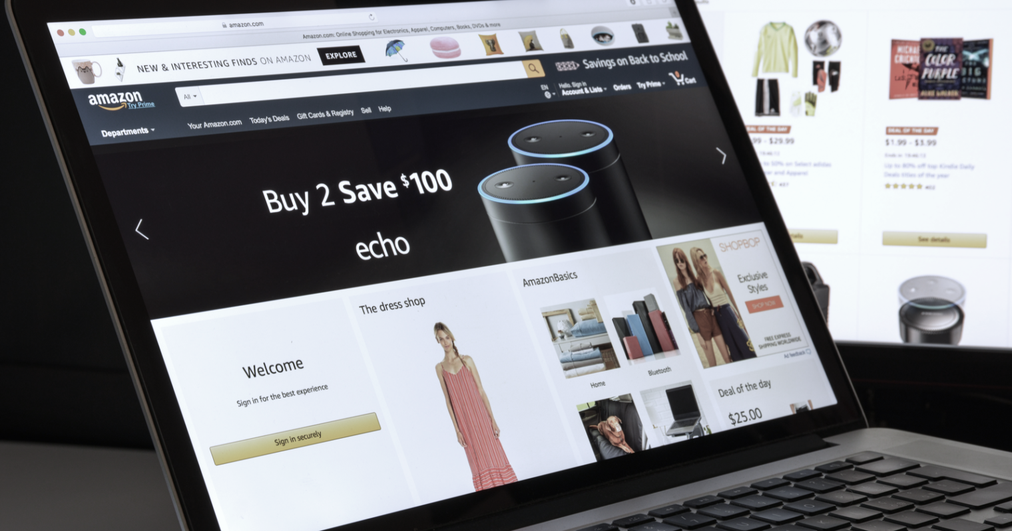
Table of Content
Introduction
Past Works
Data Understanding & Preparation
Modelling
Evaluation
Notes:
Introduction to recommender system within an E-commerce context and why it is important and what are some problems we aim to tackle
Review some past works to identify gaps that allow to use to build a general direction for the eventual approaches.
Understand the data we are working with to build the recommender system and conduct initial data preparation that is required for subsequently modelling process.
We will build two unique approaches to recommender system and a few models for baseline comparison.
Evaluate all models built using two key metrics.

Slide 3
1. Introduction
Understanding Recommender Systems

Slide 4
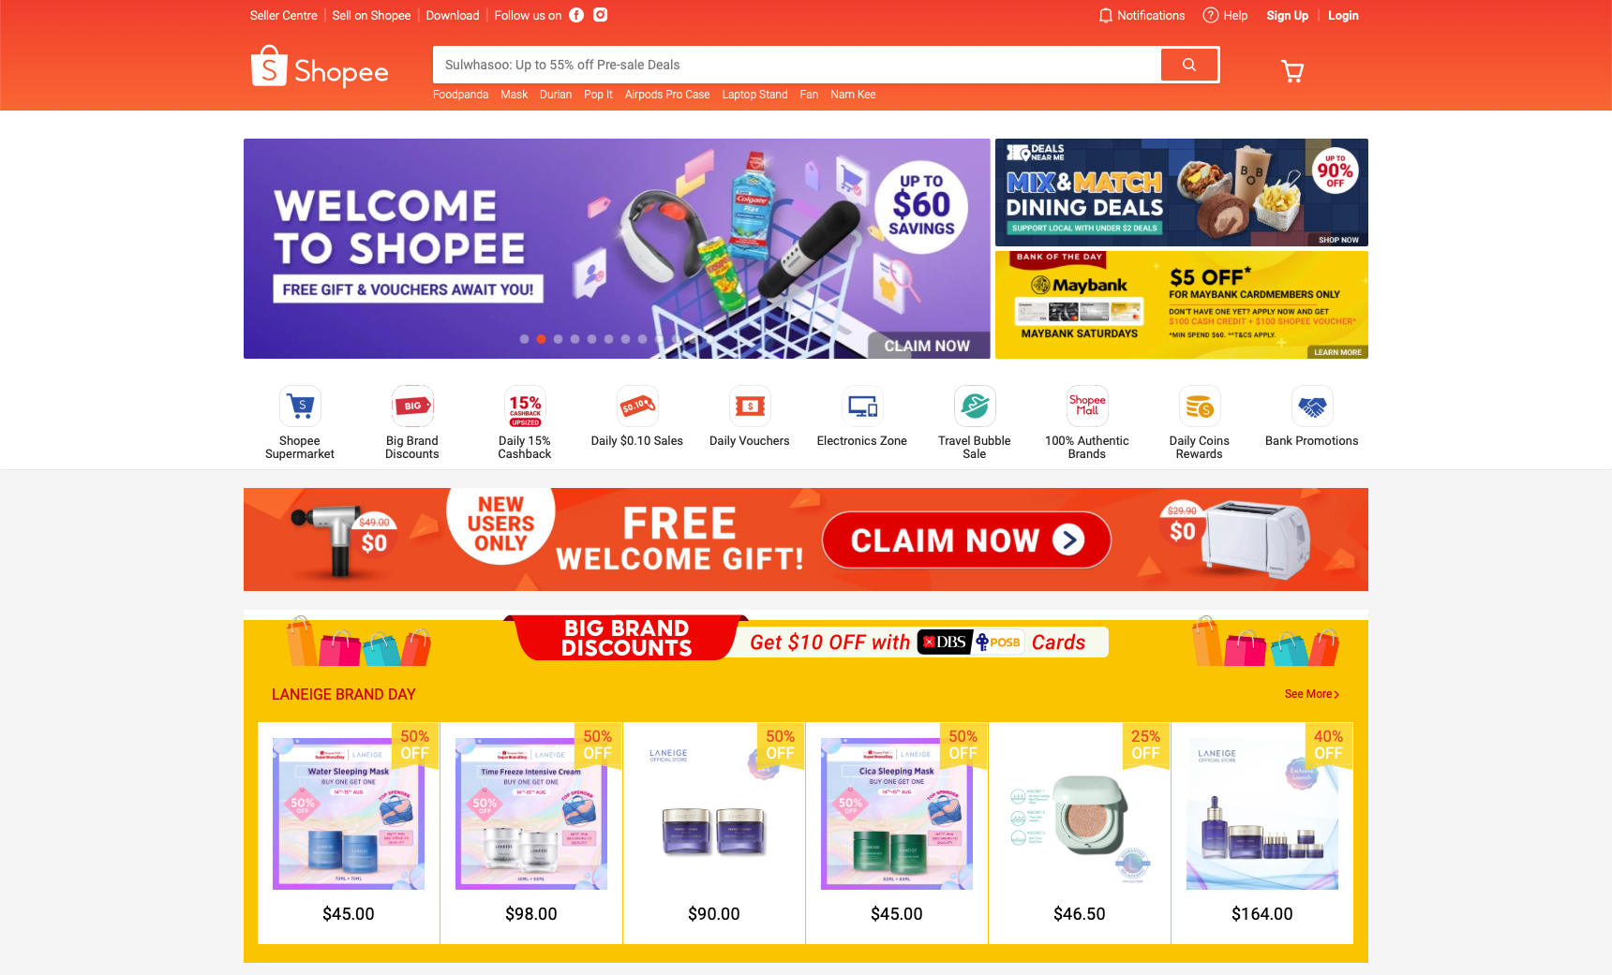


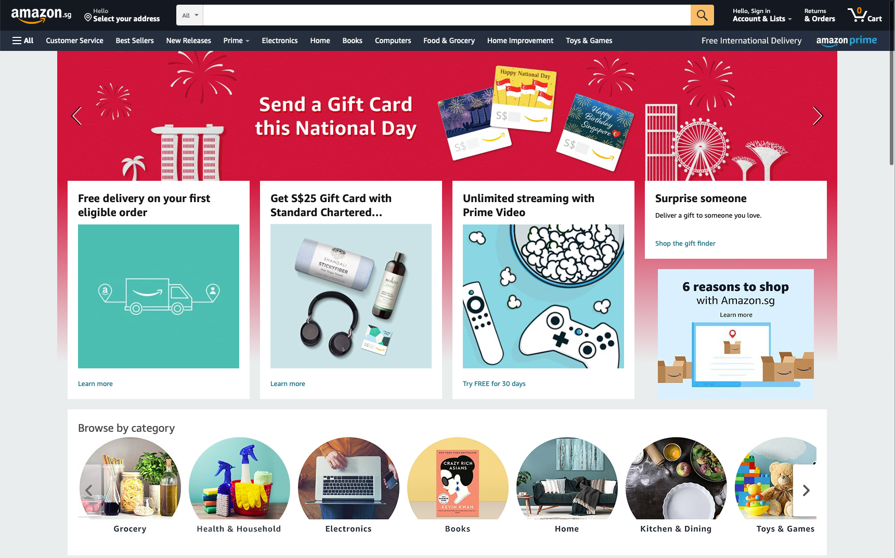
Introduction
E-commerce industry have been experiencing tremendous growth, account for approx. 2.7% of global output.
Recommender System (RS) is a crucial feature in many E-commerce platform alleviating information overload.
Several key problems plagued existing RS such as Data Sparsity and Cold Start.
BACKGROUND KEY PROBLEMS BUSINESS UNDERSTANDING
Notes:
E-commerce industry has been experiencing tremendous growth in recent years as part of a on-going digitalisation efforts.
As brick-and-mortar stores shift digitally, more users and items enters E-commerce platforms to capture increasingly savvy online consumer.
With ever increasing amount of information at hand, RS is increasingly important to provide user with the best experience possible.
RS is a crucial feature on E-commerce platforms serving as an information filtering tool that provides users with relevant and appropriate tailored to their click or purchase history.
It also helps in alleviating negative experiences associated with information overload which is particularly daunting for novice consumers who find it unfamiliar to navigate the platforms, unable to purchase items that best suits their need and preferences.
However, as E-commerce platforms expands in size, key problems such as Data Sparsity and Cold Start arises, which are problems that affects overall recommendation quality.

Slide 5
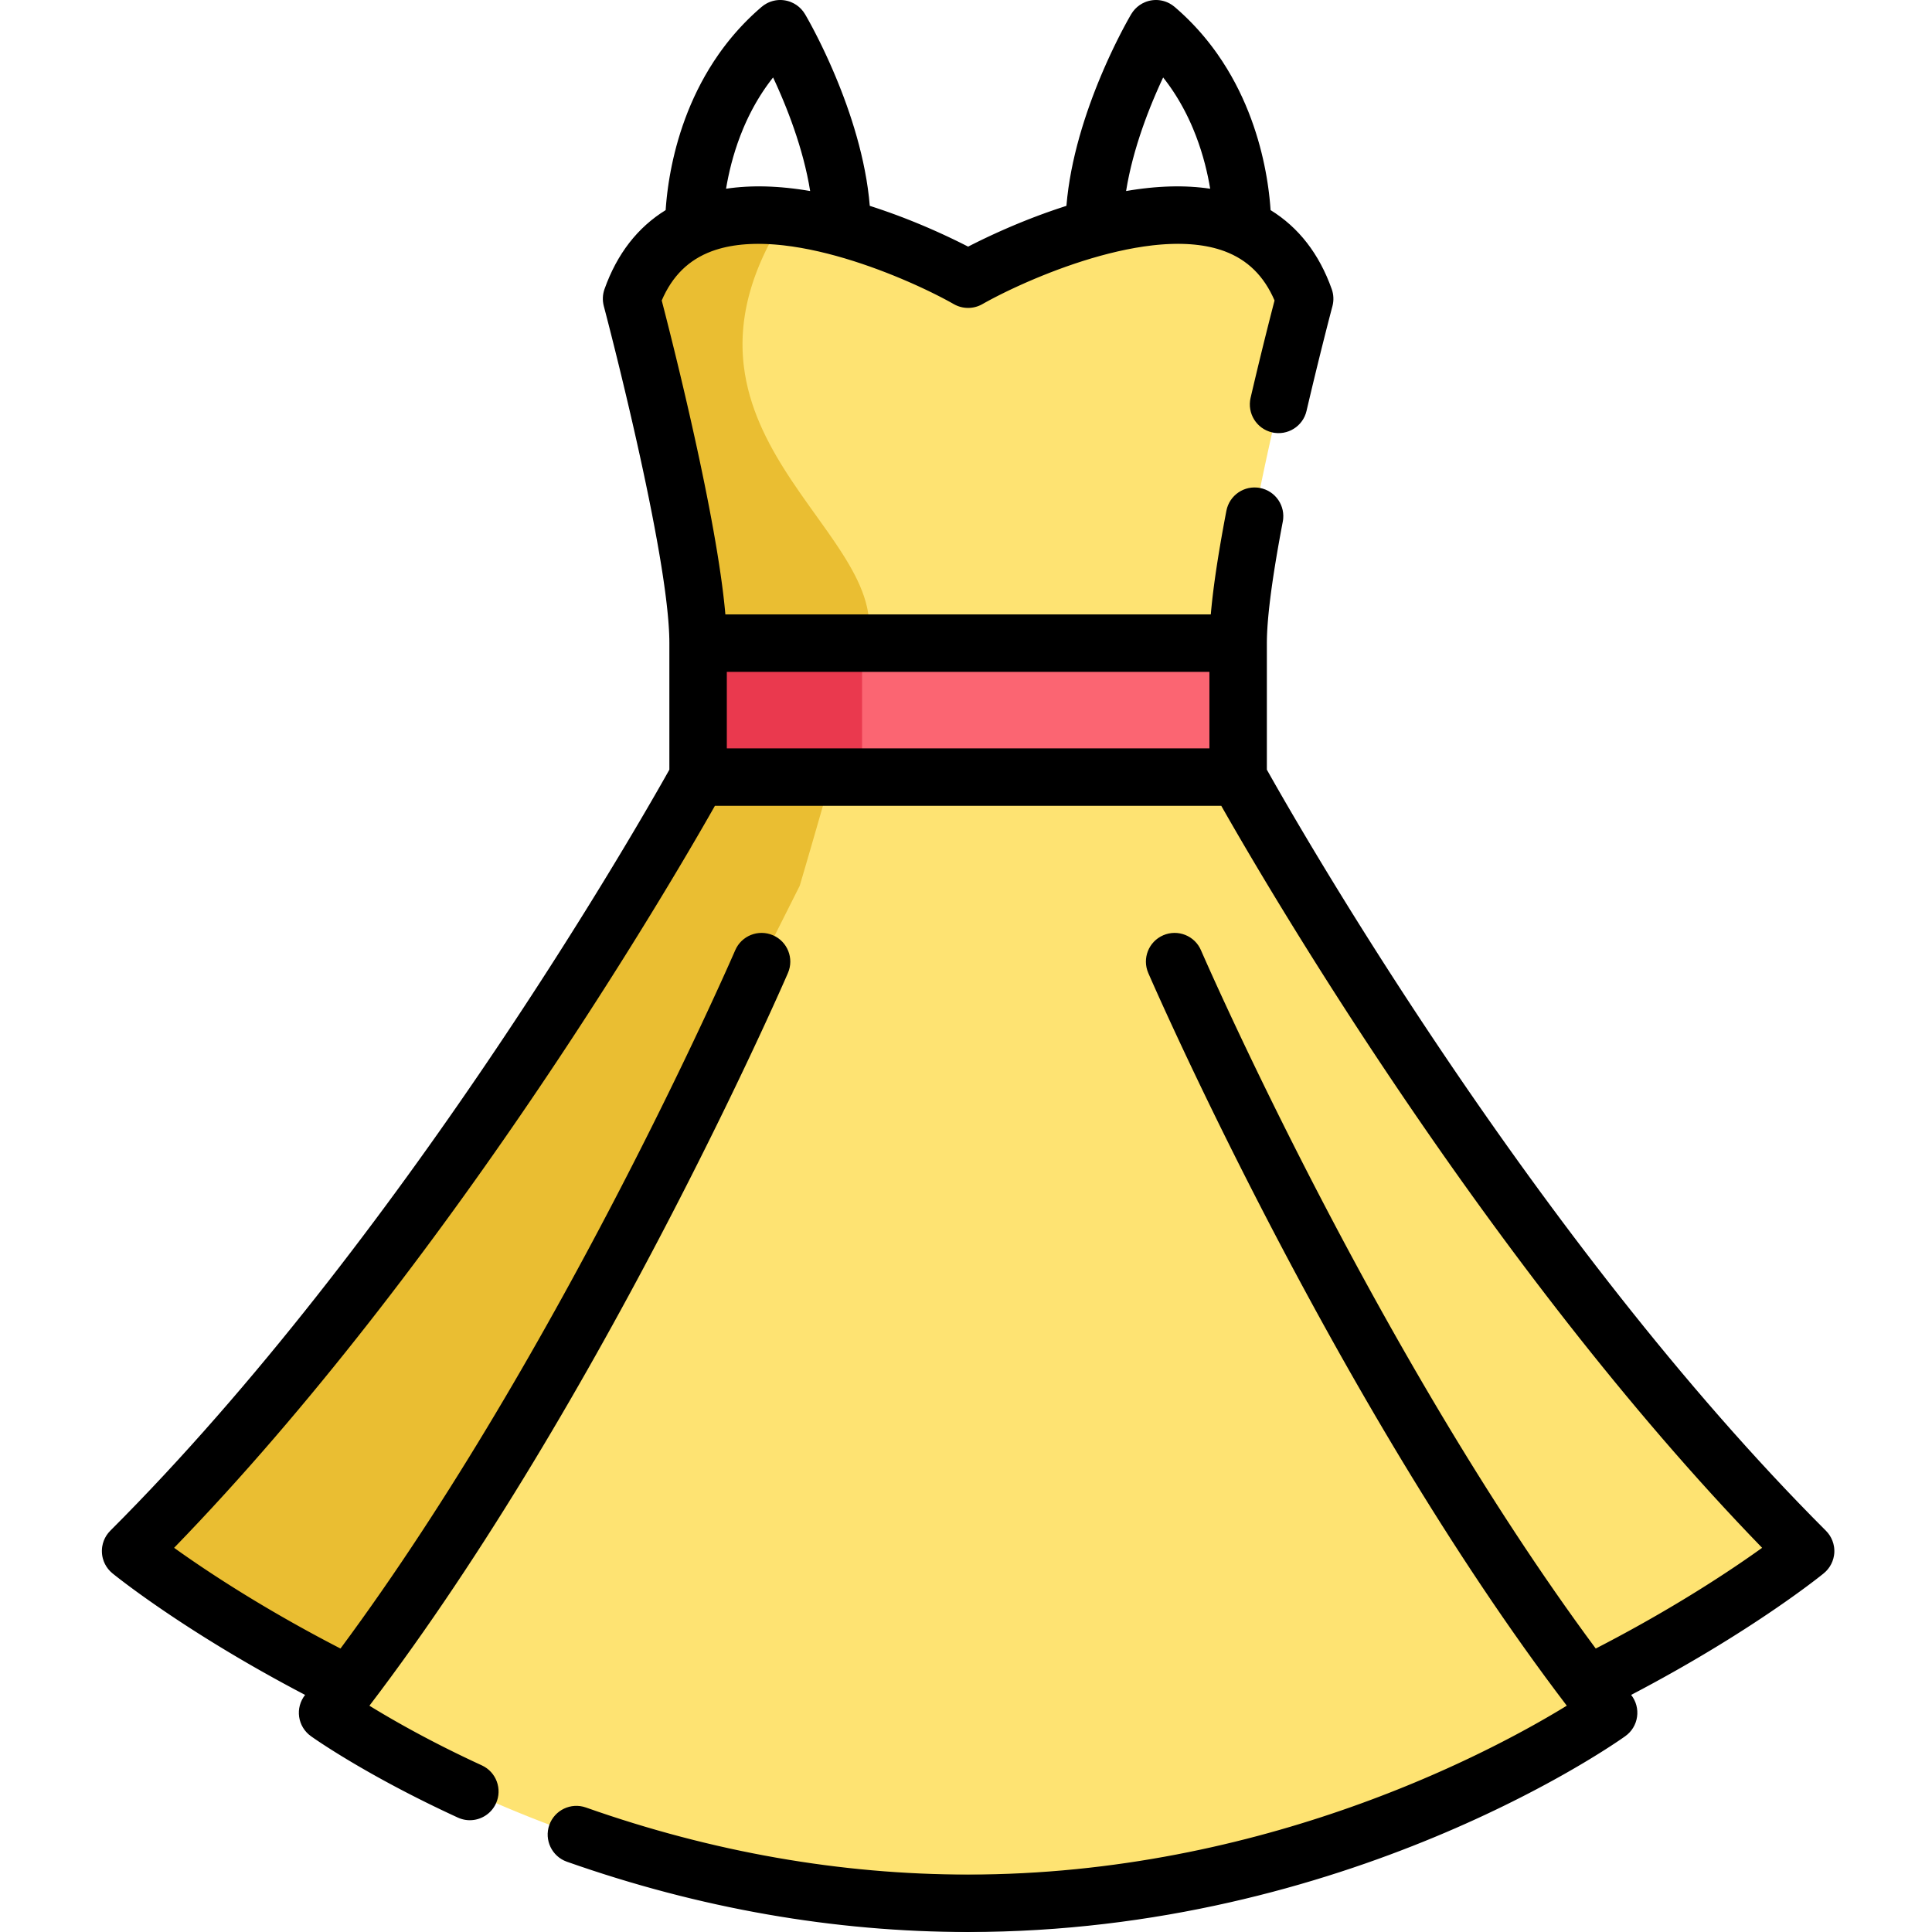






Traditional Approaches
One-piece
Both purchased
Bought
Similar
Casual
Smart Casual
Similar
Recommended to
Bought by
Recommended to
Two-piece
Memory-based
Collaborative Filtering
(e.g., K-nearest neighbor)
Model-based
Collaborative Filtering
(e.g., Matrix Factorization)
Content-based Filtering
(e.g., Cosine-similarities)
BACKGROUND KEY PROBLEMS BUSINESS UNDERSTANDING
Notes:
We need to first understand the traditional algorithms of Recommender to be able to adapt for new use cases.
CF involves leveraging a community of users and product ratings, while CBF involves only the target user and often features or item descriptions to generate recommendations.
Diving deeper into CF, the memory-based approach involves finding a small community or neighbourhood of similar users to derive candidates items which the target user has not purchased before in a recommendation task.
Meanwhile in model-based, we are interested in developing a model that characterised both hidden user and item characteristics within their rating behaviours to derive the rating for a user-item pairing based on the hidden characteristics to formulate candidates items for recommendation
In contrast, CBF involves defining features or extracting features from item descriptions to evaluate similarities given a target user’s purchase history and the key features the history exhibits.
CF is largely the most popular approach in developing RS and it is as such within an E-commerce settings.
As such, there are two key problems that plagues CF RS.

Slide 6
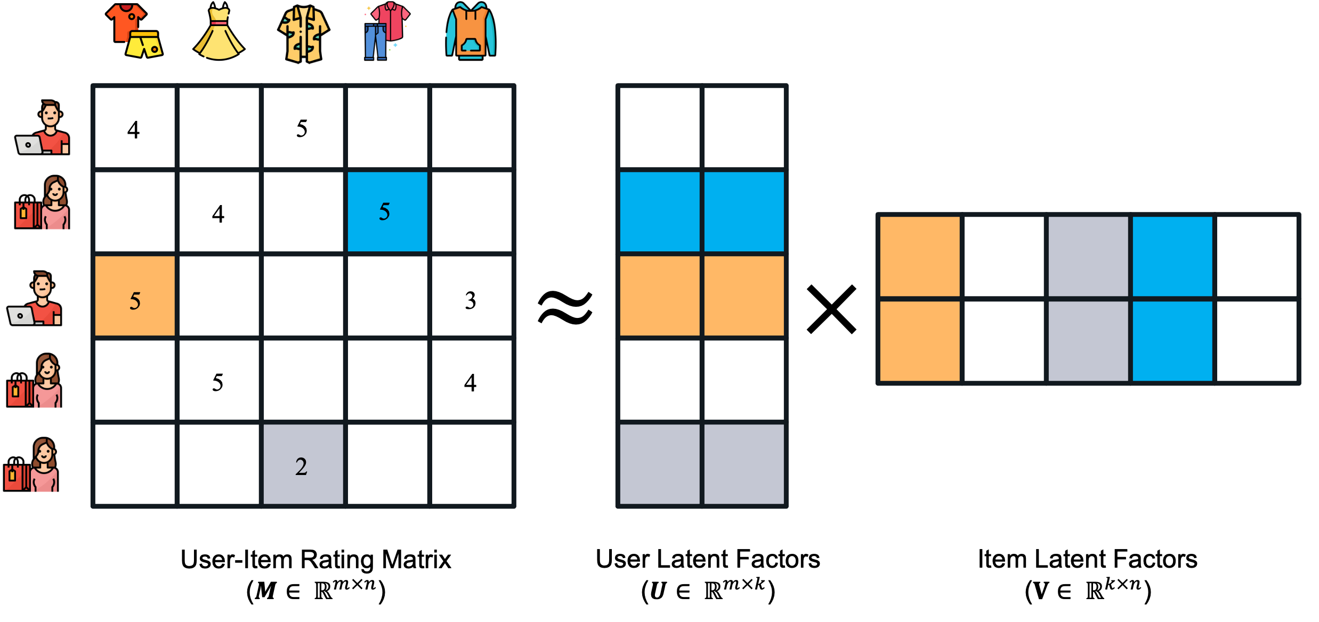
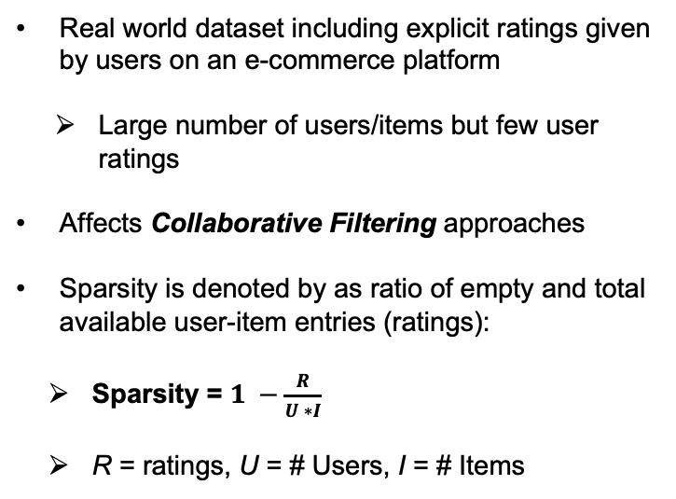
Data Sparsity
Missing Data
Real world dataset including explicit ratings given by users on an e-commerce platform
Large number of users/items but few user ratings
Affects Collaborative Filtering approaches
Sparsity is denoted by as ratio of empty and total available user-item entries (ratings):
Sparsity = $1 −\frac{R}{U ∗I}$
R = ratings, U = # Users, I = # Items
?
?
?
?
?
?
?
?
?
?
?
?
?
?
?
?
BACKGROUND KEY PROBLEMS BUSINESS UNDERSTANDING
Notes:
Data sparsity involves the fact that, a typical user on a E-commerce platforms will only tend to access/purchase a small subset of items that are available.
If we were to characterise the rating history of each users and items available on the platforms, as seen in the matrix on the left, we will observe that the matrix will be missing alot of data points, hence also known as a sparse matrix.
The key issue with having a sparse matrix is that we are missing alot of information to better construct user and item profile and characteristics, resulting in poor quality in recommendations in extreme cases.

Slide 7
Cold Start
Increasingly common due to the growth of e-commerce platforms
Rapid increase in new user/items entering the platform
Mainly affects Collaborative Filtering approaches
Difficult to generate recommendations for new user or recommend new items if we barely know any information on what they like or how an item is perceived.
Purchased
Purchased
Rated
Rated
5
5
5
5
5
5
5
3
4
5
Which user is easier to generate recommendation for?
Which items would you more confidently recommend to an user?
5
2
5
BACKGROUND KEY PROBLEMS BUSINESS UNDERSTANDING
Notes:
Cold start involves the fact that new users that joined or new items that are listed on the platforms do not have enough information that not allow for a strong assumption of the user or item profile for recommendations.
Without enough information in terms of rating behaviours from user or ratings received by users, we are unable to generate quality recommendations for both user as well as recommend the item to user.
Think about it in terms of if a user buys a lot of shirt, it will be logical for us to assume he likes shirt hence we can recommend new shirt for him but if a user only purchase 1 item before, the question lies -> can we really assume that is the category of item we would like to recommend that really captures the overall preference.

Slide 8
Problem Statement
Definition
It is increasingly challenging to generate quality Top-N recommendations solely based on product ratings given the sheer size of today’s E-commerce platforms. We want to explore incorporating new sources of information (product reviews) to help improve the recommendations.
BACKGROUND KEY PROBLEMS BUSINESS UNDERSTANDING
Notes:
We find it increasingly challenging to generate quality recommendations for users but we believe that incorporating new source of information might help tackle this situation
In our project, we would want to look into incorporating product reviews in a recommender system context as the project direction.

Slide 9
Business Objective
Business Objective
We are expected to recommend more relevant items to users and expose users to a much diverse selection of products in order to drive user trust in the platform to forge stronger customer loyalty.
BACKGROUND KEY PROBLEMS BUSINESS UNDERSTANDING
Notes:
Reach out to users on our platform with more quality and relevant items while ensuring we offer a diverse recommendations with high product coverage.
All this boil downs to the fact that we would want to drive user trust by understanding users preference much better to forget loyalty to the platform to lower customer attrition

Slide 10
Data Mining Objective
Data Mining Objective
The RS is regarded as a Top-N Recommendation task, in which we will leverage product reviews as a new source of data to improve recommendation accuracy by predicting future purchases based on user purchase history.
BACKGROUND KEY PROBLEMS BUSINESS UNDERSTANDING
Notes:
The object is a top-n recommendation task where want to improve existing recommendation accuracy.
We define the success of the project where the approaches we proposed outperforms existing traditional algorithms.

Slide 11
2. Past Works
Summary of Recent Studies

Slide 12

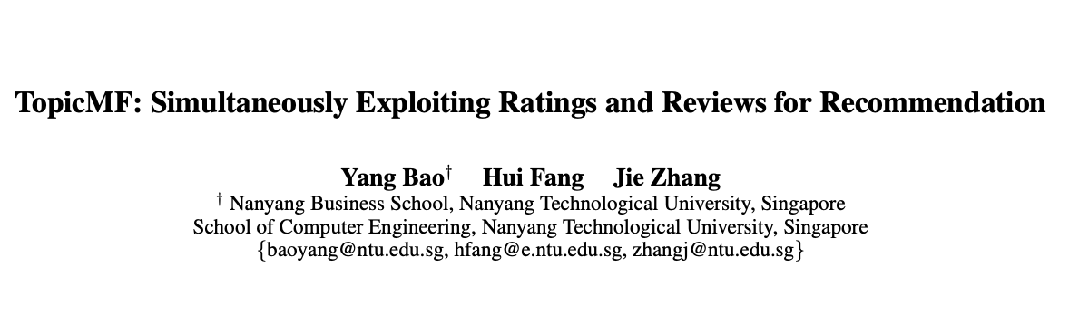
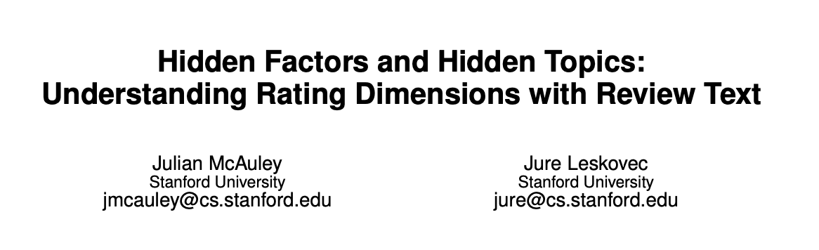
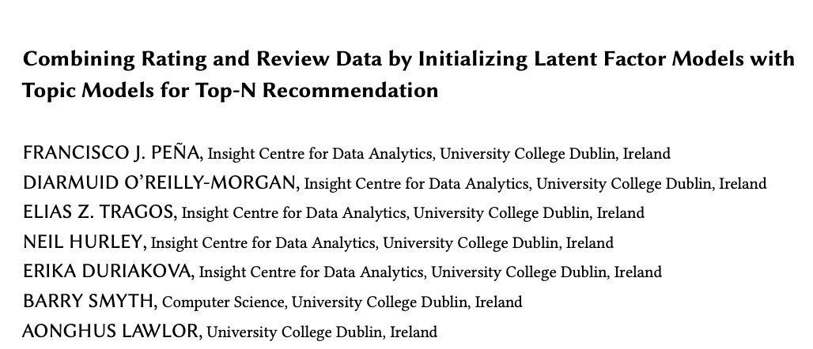

Past Works
Initial works were manual in nature in an ontology-based RS (Aciar et al., 2006).
Unsupervised techniques emerges when incorporating review texts in RS (McAuley & Jeskovec, 2013; Bao et al., 2014; Alexandridis et al., 2019; Peña et al., 2020).
Latest techniques were complex and review text were generally represented in ways that lack semantics and context, except in Alexandridis et al., (2019).
Generally, studies conducted in the form of rating prediction.
PAST WORKS
Notes:
Initial review-based recommender is no longer feasible in today’s context as it requires a pre-defined ontologies, which has to be constantly changing due to increasing new and more features in items, having ontology also means appropriate domain knowledge is required to best defined the right ontology
Meanwhile currents studies involves unsupervised representation learning to incorporate reviews in complex transformation with product ratings for recommender.
Also, the reviews are represented through TF-IDF or topic modelling which do not capture the meaning or context within the review.
As such, this project aims to develop a recommender that is able to use reviews that are represented both semantically and contextually.

Slide 13
3. Data Understanding & Preparation
Exploratory Data Analysis and Text Pre-processing

Slide 14
Overview of Amazon Categories Dataset
Table 1
Amazon Dataset Characteristics by Category
Category | #Users | #Items | #Reviews | Sparsity (%)
Pet Supplies | 19,738 | 4,950 | 94,334 | 99.89
Grocery and Gourmet Food | 14,418 | 4,799 | 77,604 | 99.89
Note. Characteristics are defined by words per review, with the exception of Unique, which covers the entire review corpus.
DATA UNDERSTANDING DATA PREPARATION
Notes:
Before we can build a recommender system we first have to understand the data we are working with.
We chosen to work with an amazon e-commerce data by Julian McAuley that provides both production ratings and reviews for us to work on.
I chose the two category pet supplies and grocery and gourmet food due to them being smaller in nature, fitting within our computation limits.
On key to observe is the sparsity with the dataset where both category are 99.9~ sparse in nature, which can potentially pose issues in traditional algorithms.

Slide 15
Data Dictionary
Table 2
Data Dictionary for Finalized Dataset
Feature Name | Description | Data Type | Values
asin | Amazon ASIN | String | A1358PQON9ZAK4
title | Product Title | String | Ateco Food Coloring Kit, 6 colors
categories | Product Category | String | ['Grocery & Gourmet Food', 'Cooking & Baking', 'Food Coloring']
reviewerID | Reviewer ID | String | 0000013714
overall | Product Ratings | Numeric | 1-5
reviewText | Product Review | String | “The product is good…”
reviewTime | Date of review | String | “05 28, 2013”
DATA UNDERSTANDING DATA PREPARATION
Notes:
Subsequently the overall feature set is observed where we are most interested in product ratings and reviews.

Slide 16
Raw Reviews Text Summary
Table 3
Raw Review Texts Characteristics by Length
Category | Minimum | Maximum | Mean | Median | Unique
Pet Supplies | 1 | 2,652 | 87.44 | 58 | 231,430
Grocery and Gourmet Food | 1 | 3,368 | 91.84 | 64 | 230,912
Note. Characteristics are defined by words per review, with the exception of Unique, which covers the entire review corpus.
DATA UNDERSTANDING DATA PREPARATION
Notes:
AS we are working with product reviews, we would also take a look at the category review profile where both category shares rather similar profile in terms of means and median words used.

Slide 17



Text Pre-processing Flowchart
Raw Reviews
Expand Contractions
Remove Special Characters
Lower Case
Raw Review: e.g., “This curry paste makes a delicious curry. I just love the...”
Contractions: e.g., “These aren’t delicious -> “These are not delicious”
Special Characters: e.g., ”$%^&*
Lower Case: e.g., “The curry paste…” -> “the curry paste…”
Lemmatization: e.g., “loving” -> “love”
Stop Words: e.g., “your”, “a”, “the”, ”and”, “me”
Tokenization: e.g., [‘curry’, ‘paste’, ‘delicious’, …]
Pre-processed Review: “e.g., curry paste delicious curry fry chicken vegetable”
Pre-processed Reviews
Tokenization
Exclude Stop Words
Lemmatization
Figure 1. Text Pre-processing Flowchart
DATA UNDERSTANDING DATA PREPARATION
Notes:
In order to use unstructured data such as review text as input for recommender system, it is key to conduct prior text pre-processing to remove irrelevant information.
We start off by expanding contractions to return words back to formal words as often review are informal in nature and may have frequent contractions involved.
We also conducted text normalisation through case normalisation and as well as lemmatisation to return all words back to their base form.
We then start to remove irrelevant information such as special characters, stops words which does not contribute in understanding the meaning of the review.
Lastly tokenisation is conducted in order to proceed onto the text vectorisation model in the next stage.

Slide 18
4. Modelling
Building a review-based Recommender System

Slide 19
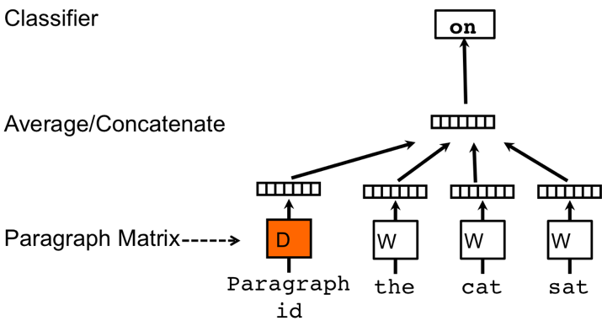
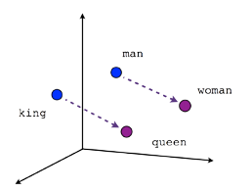
Understanding Paragraph Vector Model (Doc2Vec)
Word2Vec: representation of words in real-valued vectors, encoding meaning of the words such that similar words are closer to each other in a vector dimension space.
Doc2Vec: sum/mean aggregation of word representation vectors, to represent an entire document (reviews) as a vector representation, where similar documents are closer in vector dimension space.
Doc2Vec
Word2Vec
Figure 2. Example of PV-DM model. (Le & Mikolov, 2014).
TEXT VECTORIZATION REVIEW-BASED RECOMMENDERS BASELINES
Notes:
In order to incorporate review text into learning algorithms, we required numerical inputs.
As such it is key to vectorized and generate review representation for the algorithms we are proposing to employ.
Leveraging on the idea by Alexandridis, we adopted the Paragraph vector model which is a powerful text vectorization model that captures both meaning and context within a vector representation.
It builds on a word vectoriztaion model known as vector where we are able to generate vectors for words in way such that similar words are closer together within a vector dimension space.
This is illustrated in the diagram in the middle where words pair such as king and man are close because they are use to refer a male person while alternatively king and queen are also close together because they refer to a royalty.
With this concept in mind, the paragraph vectors averages word vectors generated to allows to represent document in the same way.
Hence, if we have reviews that address the same product such as curry powder, it will be closer to each as opposed to an review that address bread.

Slide 20
Understanding Paragraph Vector Model (Doc2Vec)
Table 5
Comparison of NLP Methods for Feature Extractions on Text
Methods | TF-IDF | LDA | Doc2Vec
Type | Bags-of-Word | Probabilistic | Neural Network
Usage | Vectorization | Topic Modelling | Vectorization
Semantics | No | No | Yes
Context | No | No | Yes
TEXT VECTORIZATION REVIEW-BASED RECOMMENDERS BASELINES
Notes:
Therefore we also compare paragraph vector to other text vectorisation techniques such as TF-IDF and LDA. The key advantages here is clear, Doc2Vec is effectively the technique can both capture semantics and context of words in review as opposed to other techniques which are based on bags-of-word approach.

Slide 21
Paragraph vectors unlike TF-IDF, Topic Modelling vectors, considers word semantics and order.
We can assume that by better capturing the rich information within reviews, we can generate better user and item profile representations.
Notes:
As such we can assume that with richer information capture within our review representation, we can similar construct better user and item profile that better represents both user and items.

Slide 22
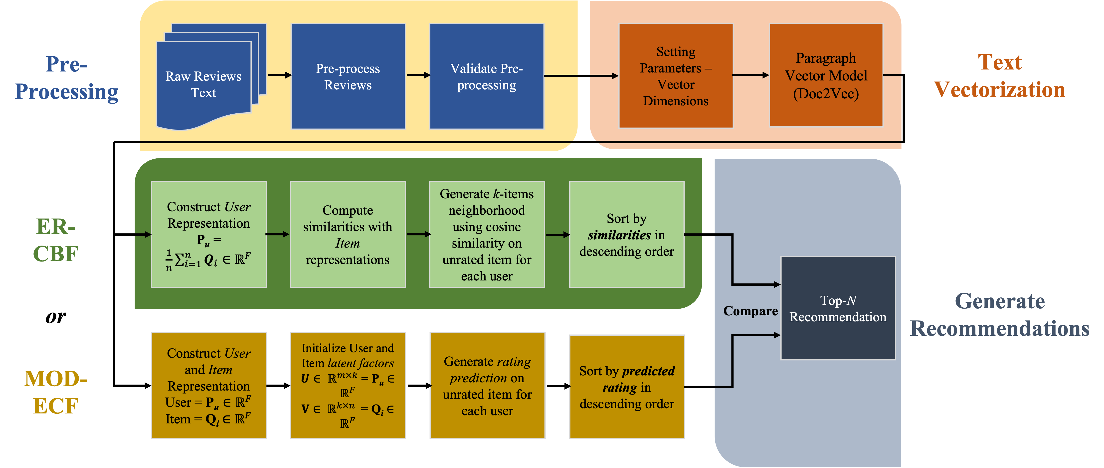
Overview of Proposed Approaches (ER-CBF & MOD-ECF)
(see Appendix A)
(see Appendix B)
Figure 3. Proposed Modelling Process
TEXT VECTORIZATION REVIEW-BASED RECOMMENDERS BASELINES
Notes:
After obtaining vectorized text, we can finally incorporate such information into a review-based recommender system.
The key thing to note here is that traditional recommender algorithm only uses product rating or item description. Hence, we need adapt such traditional algorithms for our use case.
The first approach is known as ER-CBF or embedded review content-based filtering which builds on the concept of content-based filtering. They key idea is here is that we generate item representation through paragraph vector model then using the item representation we are also able to construct the user representation.
From there we simply build a k-neigbour food of similar item through cosine similarity against item which a target user has not rated before to generate the candidate item required.
Meanwhile instead of solely product reviews for recommendations, another model known as mod-ecf or model-based embedded collaborative filtering adapts on traditional matrix factorisation techniques through fix initialisation of the process to generate user and item characteristics.
Matrix facrtoaization is usually random initialised to form two small matrices that represented both user and item hidden characteristic which are used to generate rating prediction for a given user and item pairing.
We instead pre-build the user and item characteristics via paragraph vector model then generate candidates item required for the recommendation task.

Slide 23
Baseline Comparisons
“Baseline Comparisons
Traditional
User-based Collaborative Filtering (UB-CF)
FunkSVD (Matrix Factorization)
Previous Work
Topic-initialized Matrix Factorization (TI-MF)
Initializing FunkSVD using Topic Modelling vectors
Similar to Peña et al. (2020)
Random
Random Normal
Predict random ratings given normal distribution.
TEXT VECTORIZATION REVIEW-BASED RECOMMENDERS BASELINES
Notes:
To compare our review-based recommenders, we have to compare with tradition algorithms that only employs ratings to see if product reviews does in fact helps to improve recommendations
Traditional algorithm such as user-based collaborative filtering and funksvd are reliable algorithms frequently used in recommrenaton task.
We also adapted the idea we build MOD-ECF by modelling the approach does by Pena which conducted fix initialisation via topic modelling vectors instead.
Lastly we have a random recommenders that serve as control model to ensure that our algorithms should always be achieving higher accuracy that randomised recommendations.

Slide 24
5. Evaluation
Evaluating the Recommender System’s Performance

Slide 25
Experimental Setup
“Predict future purchases based on past purchases”
Why
Generate Top-N recommendations and compare to latest holdout test items based on user’s purchase history, mimicking a typical consumer lifecycle.
How
Order user’s rating history chronologically based on review time, and split history by 70/30 ratio, leaving 30% of the items for evaluation.
Caveat
Minimal user history should have two items to allow possible splitting. User and item in test set should both appear in the train set.
EXPERIMENTAL SETUP METRICS RESULTS FINDINGS & DISCUSSION
Notes:
We set up the training of proposed approaches based on the idea of predicting future purchase based on past purchases
We arrange user’s rating/purchase history chronologically using the earliest 70% purchased item for training, while testing our recommendations based on the latest 30% purchased items.
The rationale behind such experimental setup is to assume a logical user purchase behavior on e-commerce platform, where past purchases often influence fture purchase.

Slide 26
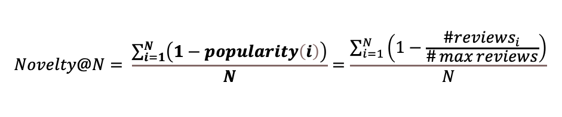
Evaluation Metrics
Recall@N: how many items recommended did users already purchased?
$$Recall@N= \frac{\# relevant items recommended}{\# relevant items}=\frac{\# test set items recommended}{\# test set items}$$
*Novelty@N: are we able to recommend items that are not as popular?
$$Novelty@N= \frac{\sum_{i=1}^{N}{\left(1−popularity\left(i\right)\right)}}{N}=\frac{\sum_{i=1}^{N}{\left(1−\frac{\#{reviews}_{i}}{\#\max{reviews}}\right)}}{N}$$
EXPERIMENTAL SETUP METRICS RESULTS FINDINGS & DISCUSSION
Notes:
To evaluate the models, we look into accuracy in the form of recall@n where in particular we would like to a recommender system that achieve higher recall as compared to others across all set of number of. Items recommended
Meanwhile, we also evaluate the model in a different perspective through novely@n where, we are evaluating a RS based on their ability to handle cold-start in item, where we want a recommender system to be able to adequately recommend new items with little information such as ratings and reviews which are traditionally a problem in traditioinal algrotihsm such as collaborative filtering.
Just to note that popular items refers to item with the more reviews, in contrast, items are less popular if little people has purchased them before, resulting in low number of ratings/reviews

Slide 27
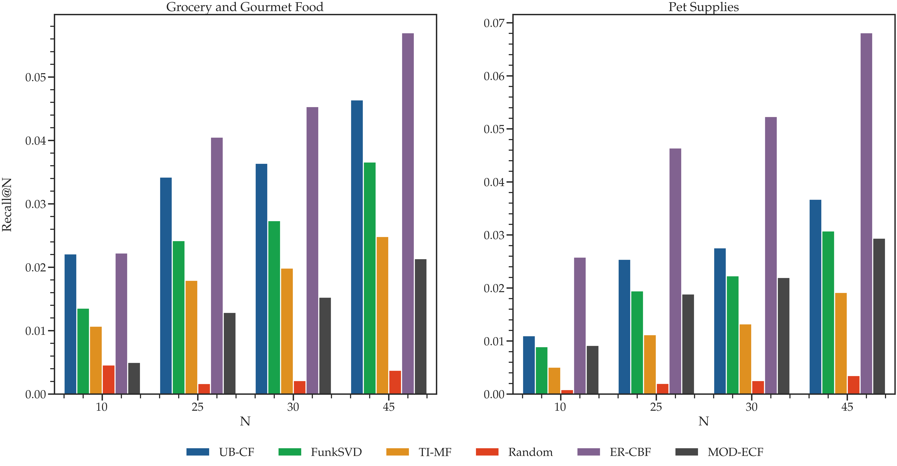
Results: Recall@N
Figure 4. Recall@N, where N = {10, 25, 30, 45}
EXPERIMENTAL SETUP METRICS RESULTS FINDINGS & DISCUSSION
Notes:
On a very high level overview of the results, we can observe very promising results.
Our proposed method ER-CBF has shown better performance or accuracy in recommending items as compared to the other algorithms. For majority of the N-items for both categories, ER-CBF consistently outperforms the other models.
This mean that when trained on user’s earlier purchse history, ER-CBF is the best model in capturing an idea of what other users might subsequently purchase as we setup our experiment by keeping the latest 30% of the items purchased as test items of which we wanted to see if our recommendations can identify the said items.
Although traditional aglorithms such as UB-cf and funksvd are seen as reliable algorithms for recommender tasks, we do note that with data sparsity and cold start observe within our dataset, they did not perform as well as expected.
Meanwhile for both fix-initlized models such as TI-MF and MOD-ECF, performance in a top-n recommender task is rather unreliable.
However, we do want to highlight a point that MOD-ECF which leverage on paragraph vector did managed to outperform topic modelling vectors in pet supplies which point to the fact that pet supplies review may be more detailed in nature, which better captured user and item characteristics resulting in better performance.

Slide 28
Results: Recall@N
Table 6
Top-N performance evaluated by Recall@N
Algo. | Amazon Grocery and Gourmet Food |  |  |  |  | Amazon Pet Supplies
 | Recall@10 | Recall@25 | Recall@30 | Recall@45 |  | Recall@10 | Recall@25 | Recall@30 | Recall@45
UB-CF | 0.02210 | 0.03423 | 0.03640 | 0.04639 |  | 0.01101 | 0.02542 | 0.02758 | 0.03673
FunkSVD** | 0.01355 | 0.02420 | 0.02735 | 0.03659 |  | 0.00893 | 0.01945 | 0.02230 | 0.03075
TI-MF** | 0.01070 | 0.01795 | 0.01987 | 0.02485 |  | 0.00507 | 0.01119 | 0.01325 | 0.01916
Random | 0.00046 | 0.00166 | 0.00213 | 0.00376 |  | 0.00085 | 0.00202 | 0.00256 | 0.00349
ER-CBF* | 0.02225 | 0.04052 | 0.04535 | 0.05699 |  | 0.02583 | 0.04642 | 0.05234 | 0.06814
MOD-ECF*** | 0.00499 | 0.01288 | 0.01528 | 0.02136 |  | 0.00919 | 0.01888 | 0.02200 | 0.02940
Note. All matrix factorization-based algorithms are defined with a factor size of k=50. Similarly, the review representations in our proposed approaches are defined with a dimension size of n=50. *Doc2Vec settings: {epochs=10, window=5, min_count=1} **Matrix Factorization models settings: {epochs=10, learning_rate=0.005, regularization=0.1}
EXPERIMENTAL SETUP METRICS RESULTS FINDINGS & DISCUSSION

Slide 29
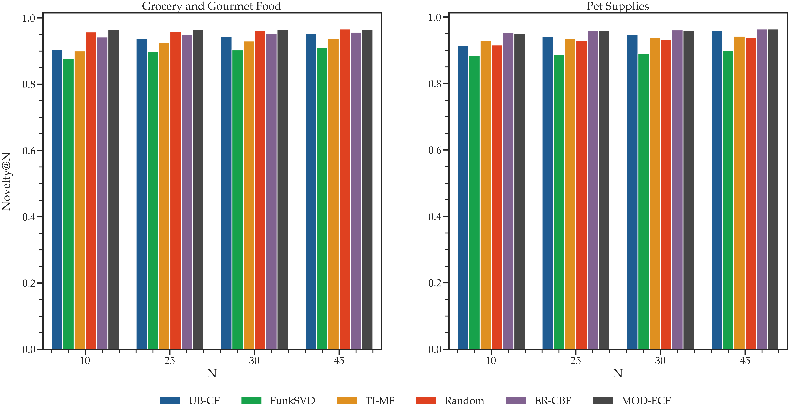
Results: Novelty@N
Figure 5. Novelty@N, where N = {10, 25, 30, 45}
EXPERIMENTAL SETUP METRICS RESULTS FINDINGS & DISCUSSION
Notes:
When interpret novelty, we have to condsider accuracy as well as novelty is not a concusive metrics to best determine a recommender system performance but rather acts alternative way to help us evaluate recommender system performance in specific context.
For instance, if you have poor accuracy but high novelty it simpy means that you are randomly recommending items however, if a model has high accuracy and also high novelty, it means that it can captures both user prefrences while also considering the overall product coverage within the plaform.
As a heads up, when novely approach 0 - it means that our recommender is soley functioning as popularity-based recommender which means that we are only recommending popular items. Meanhiwl if novelty approach 1, it means that we are only recommending new items with relatively little information.
Hence, novelty should strike a balance and should be evaluated in relative to other models and also consider together with accuracy to best identify the possible performance of a recommender system.
Generally most models were able to table novelty adequately but traditional agroithms siuch as ub-cf and funksvd falters slight in smaller n sizes, while funksvd in particularly being more popularity-focused across all n sizes in both categories.
This is understandable as studies has often observed methods such as collaborative filtering to be gravitate towards popular items more which is a matter of probability
Because if you are depending on community of users for your recommnedations process, items which are more popular with more ratings and reviews are likely to appear within your community users more often based on probability.
Hence, based on the results we observed, we can say that both our proposed algorithms performed adequately in possibly tackilingt he cold start issue.
But with accuracy in mind, we can conclusively say tat for now, ER-CBF is the best performing model in terms of accuracy and also demonstrated its strength in tackling cold start in terms which plagues traditional algorithms.

Slide 30
Results: Novelty@N
Table 7
Top-N performance evaluated by Novelty@N
Algo. | Amazon Grocery and Gourmet Food |  |  |  |  | Amazon Pet Supplies
 | Novelty@10 | Novelty@25 | Novelty@30 | Novelty@45 |  | Novelty@10 | Novelty@25 | Novelty@30 | Novelty@45
UB-CF | 0.90557 | 0.93876 | 0.94462 | 0.95401 |  | 0.91555 | 0.94071 | 0.94731 | 0.95870
FunkSVD** | 0.87762 | 0.89942 | 0.90351 | 0.91186 |  | 0.88427 | 0.88741 | 0.89002 | 0.89838
TI-MF** | 0.90050 | 0.92528 | 0.93025 | 0.93792 |  | 0.93035 | 0.93601 | 0.93856 | 0.94257
Random | 0.95766 | 0.95966 | 0.96197 | 0.96668 |  | 0.91587 | 0.92872 | 0.93213 | 0.93958
ER-CBF* | 0.94243 | 0.95109 | 0.95319 | 0.95722 |  | 0.95381 | 0.96009 | 0.96143 | 0.96418
MOD-ECF*** | 0.96466 | 0.96496 | 0.96514 | 0.96580 |  | 0.94959 | 0.95902 | 0.96069 | 0.96408
Note. All matrix factorization-based algorithms are defined with a factor size of k=50. Similarly, the review representations in our proposed approaches are defined with a dimension size of n=50. *Doc2Vec settings: {epochs=10, window=5, min_count=1} **Matrix Factorization models settings: {epochs=10, learning_rate=0.005, regularization=0.1}
EXPERIMENTAL SETUP METRICS RESULTS FINDINGS & DISCUSSION

Slide 31
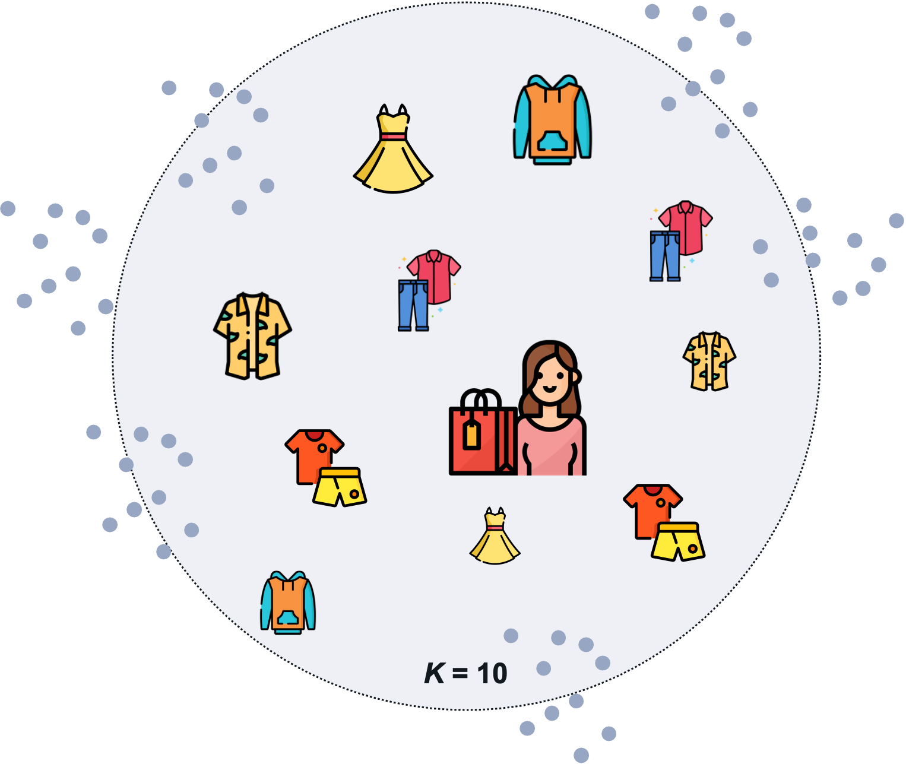
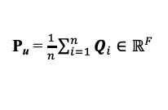
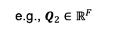
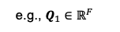
Findings & Discussion
ER-CBF has the BEST accuracy (Recall@N) and adequate Novelty@N in relative to other models.
Traditional algorithms, although reliable but were still suffering from data sparsity and cold start.
MOD-ECF were unreliable in performance, despite outperforming TI-MF in Pet Supplies.
Requires deeper cross-analysis to better understand how using review-based recommenders perform across different groups of users.
e.g., $Q_{1}∈ℝ^{F}$
P_{u} = $\frac{1}{n}\sum_{i=1}^{n}{Q_{i}∈ℝ^{F}}$
e.g., $Q_{2}∈ℝ^{F}$
Figure 6. Visual Representation of the ER-CBF model.
EXPERIMENTAL SETUP METRICS RESULTS FINDINGS & DISCUSSION
Notes:
dsi

Slide 32
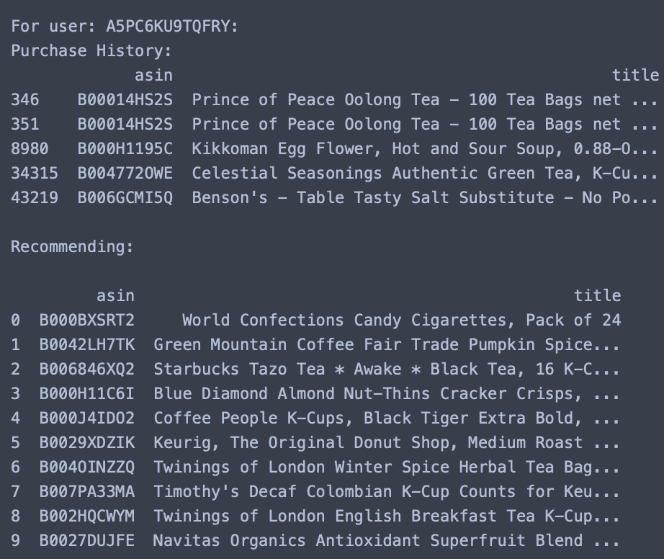
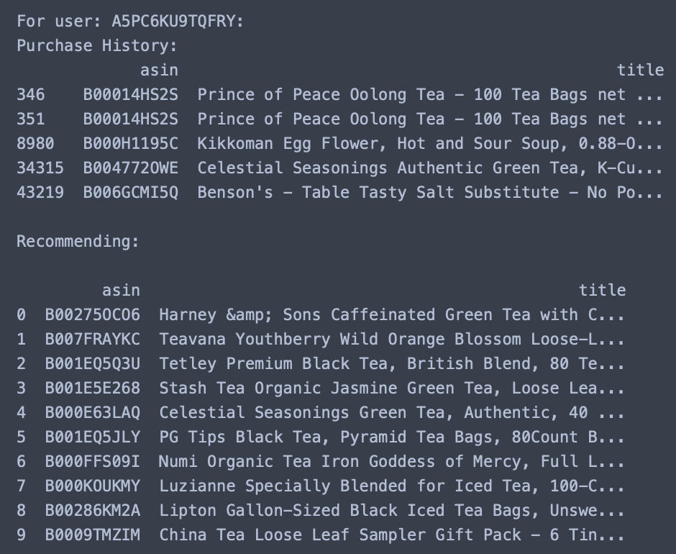
Interpreting Recommendations – Grocery and Gourmet Food
User: A5PC6KU9TQFRY
Purchased: Oolong Tea x2, Green Tea,
Table Salt, Soup
UB-CF@10:
ER-CBF@10:
Items Recommended:
Green Tea
Black Tea
Youthberry Tea
Items Recommended:
Candies
Coffee
Crackers
Breakfast/Herbal Tea
EXPERIMENTAL SETUP METRICS RESULTS FINDINGS & DISCUSSION

Slide 33
5. Further Works
Current developments and further improvements

Slide 34



Further Works
User
Deeper Result Analysis
Recall@N & Novelty@N for specific groups of users (e.g., Frequent, Average, New users)
Offline vs Online Evaluation
Methods of Deployment
A/B Strategy
Visits
E-commerce
Platform
Browsing History
Product Reviews
Purchase/Rating History
Generate Top-N
Recommendations
Data Warehouse
Users
and Items
Recommender System
Computes
Candidate Items
FURTHER WORKS

Slide 35
Thanks!
Any questions?

Slide 36
Appendices

Slide 37
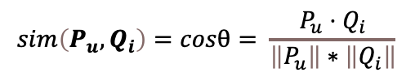
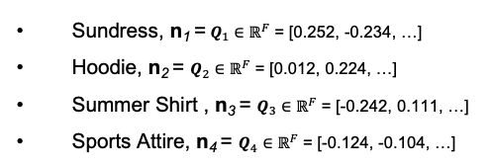
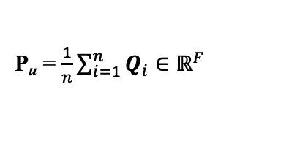
Appendix A: Embedded Review Content-based Filtering (ERCBF)
Algorithm:
e.g., $Q_{1}∈ℝ^{F}$
1. Find User P_{U} Rating History:
Sundress, n₁ = $Q_{1}∈ℝ^{F}$ = [0.252, -0.234, …]
Hoodie, n₂ = $Q_{2}∈ℝ^{F}$ = [0.012, 0.224, …]
Summer Shirt , n₃ = $Q_{3}∈ℝ^{F}$ = [-0.242, 0.111, …]
Sports Attire, n₄ = $Q_{4}∈ℝ^{F}$ = [-0.124, -0.104, …]
2. Represent User P_{U} as the mean aggregation of all rated items to:
P_{u} = $\frac{1}{n}\sum_{i=1}^{n}{Q_{i}∈ℝ^{F}}$
P_{u} = $\frac{1}{n}\sum_{i=1}^{n}{Q_{i}∈ℝ^{F}}$
3. Compute cosine similarities with all unrated items:
e.g., $Q_{2}∈ℝ^{F}$
$$\operatorname{sim}\left(P_{u}, Q_{i}\right)=cosθ= \frac{P_{u}⋅Q_{i}}{\left\|P_{u}\right\|∗\left\|Q_{i}\right\|}$$
Figure 1. K-neighborhood of Similar Items within Paragraph Vector Dimension Space
4. Formulate k-neighborhood of similar items

Slide 38
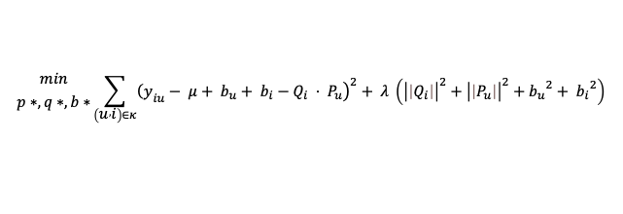
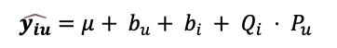
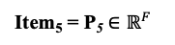
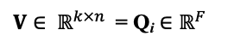
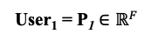
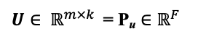
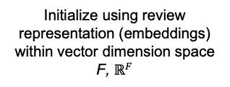
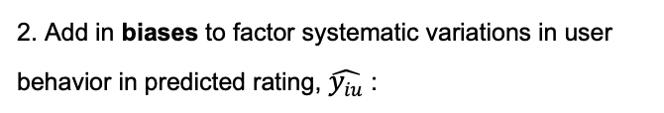
Appendix B: Model-based Embedded Collaborative Filtering (MOD-ECF)
Algorithm:
Initialize using review representation (embeddings) within vector dimension space F, $ℝ^{F}$
1. Initialize latent factors of Matrix Factorization (MF) using review embeddings from Doc2Vec:
User₁ = P₁ $∈ℝ^{F}$
$U∈ ℝ^{m×k}$= P_{u} $∈ℝ^{F}$
$V∈ ℝ^{k×n}$= Q_{i} $∈ℝ^{F}$
2. Add in biases to factor systematic variations in user behavior in predicted rating, $\hat{y_{iu}}$:
$$\hat{y_{iu}}=μ+ b_{u}+ b_{i} + Q_{i} ⋅ P_{u}$$
3. Regularize MF to prevent overfitting due to model complexity and sparse matrix:
$${min \atop p∗, q∗,b∗}\sum_{\left(u , i\right)∈κ}{{\left.{\left(y\right.}_{iu}− μ+ b_{u}+ b_{i}−Q_{i} ⋅ P_{u}\right)}^{2}}+ λ \left({\left|\left|Q_{i}\right|\right|}^{2}+{\left|\left|P_{u}\right|\right|}^{2}+{b_{u}}^{2}+ {b_{i}}^{2}\right)$$
Figure 2. Matrix Decomposition
Item₅ = P₅ $∈ℝ^{F}$
4. Optimize (3) using Stochastic Gradient Descent (SGD)

